Slide 1
Review of CAR 133911845

Slide 2
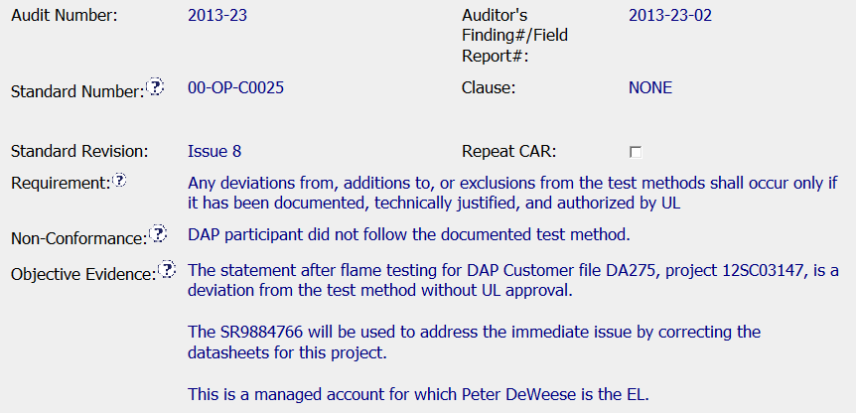
Although there is no clause in this client guidance document, suggest including a description of the location in the document to the requirement section. For instance, “last paragraph of document”.
Appropriate reference to the internal document & issue/rev
Cites specific & traceable references to evidence, including applicable SR for containment
Name used, but included in order to later identify the appropriate owner

Slide 3
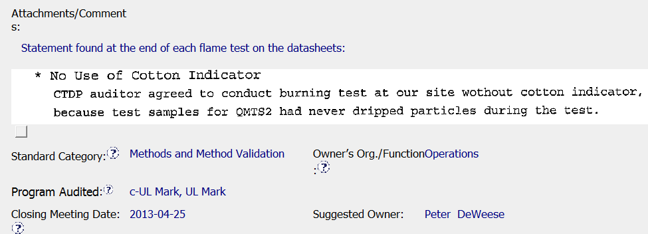
Includes screen shot from datasheets as evidence of the non-compliance
Appropriate category and owner selected based on objective evidence provided

Slide 4
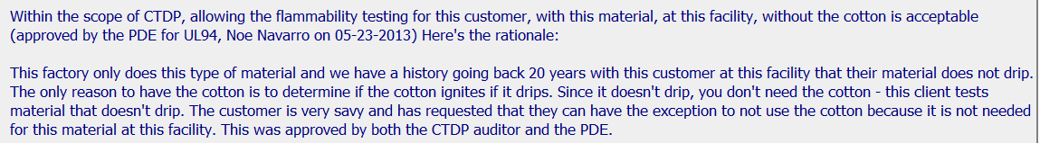
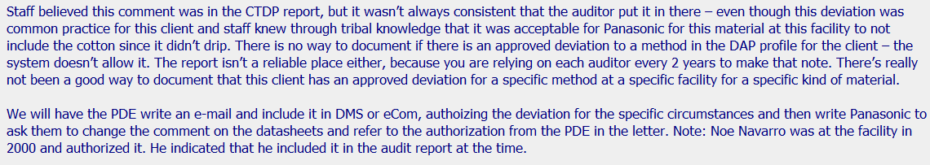
Excerpts from the analysis:
Technical justification from the PDE – explains why the actions were ok. Also used to justify why no traceback is necessary.
Following the 5 whys – covered process, staff, and technical explanation, etc.

Slide 5
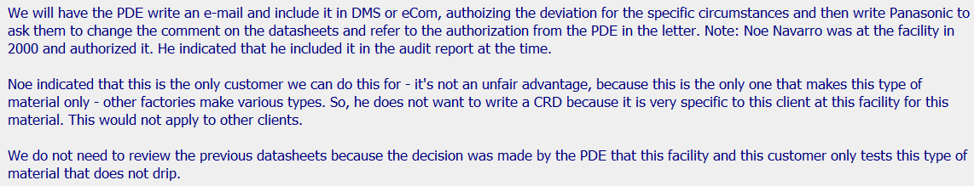
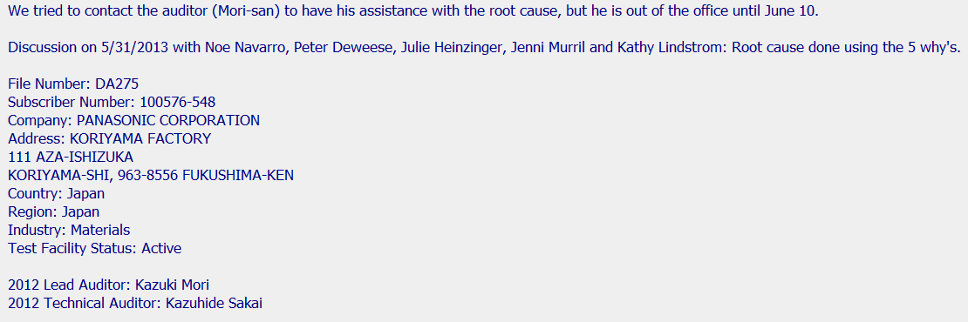
Was impartiality considered since the PDE is authorizing work that was done by himself (14 years ago)?
Analysis continued:
Explanation on why this justification cannot be applied to other customers and why it does not apply to previous testing
Stakeholders consulted along with explanation on why specific stakeholders were not consulted
Detailed file information from the DAP database

Slide 6
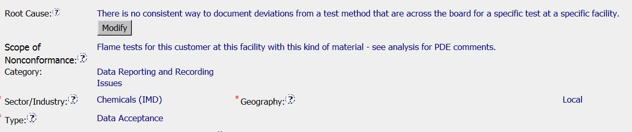
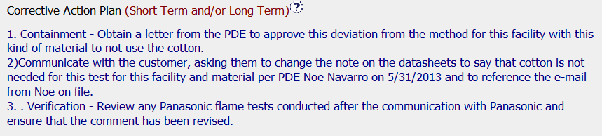
Analysis explains that deviations are customized based on the test and test facility, supporting the RC statement & scope
CAP includes basic requirements – containment, action, & verification
Suggestion for improvement – expand the corrective action to include developing a process gather and record this type of deviation in the future (for other customers or instances, even if the scope is limited to this specific instance

Slide 7
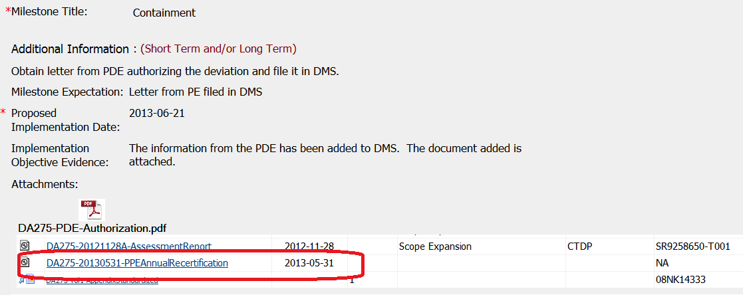
Containment appropriately shows that the test method was acceptable and that no traceback was necessary
Screen shot confirming that the record is indeed where it is said to be in the IOE above

Slide 8
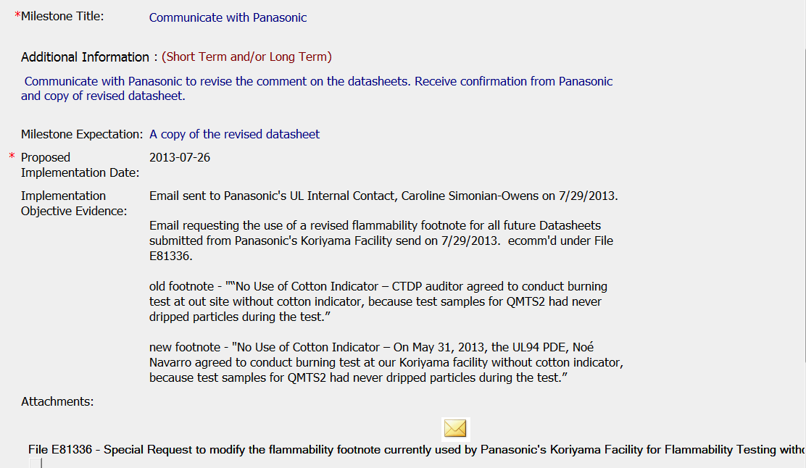
Communication with customer regarding the issue along with evidence showing that the datasheets being used by the customer have been updated to include the necessary justification for the deviation
Includes specifics of who authorized the deviation and when

Slide 9
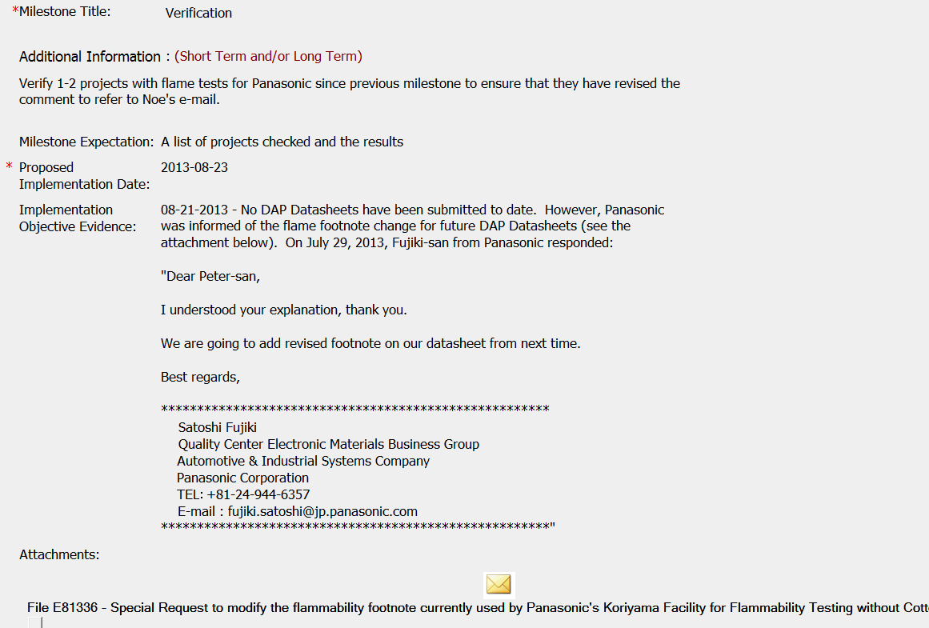
Since the typical verification evidence was not available, a confirmation of continued understanding of the requirement was included in the evidence

Slide 10
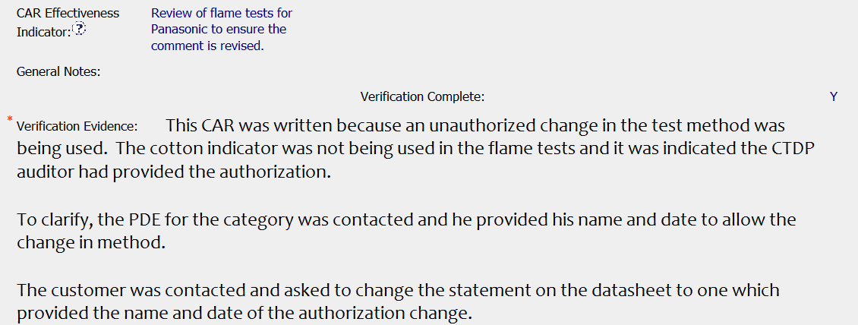
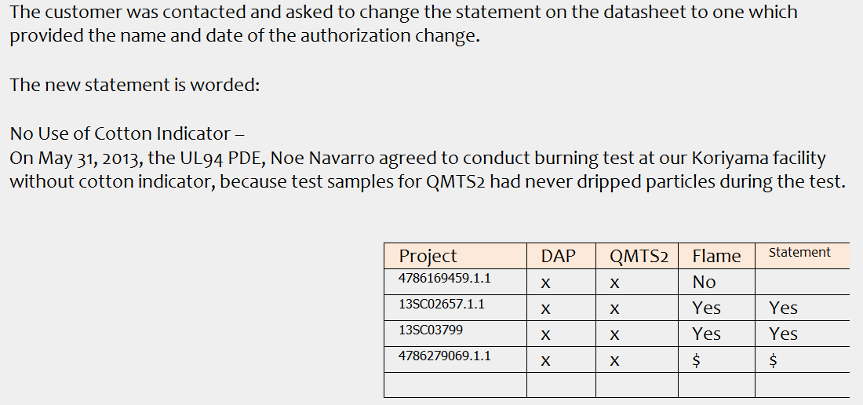
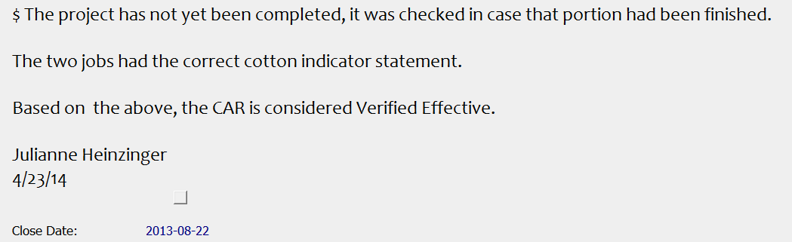
Nice summary of the background to support the verification
Details about the evidence of effectiveness
Footnotes provide details on what was found during verification and reasons why the statement was not (yet) provided

Slide 11
Summary:
Overall, the non-conformance was clearly explained and detailed notes were provided in the analysis to explain how the scope and root cause were determined.
Collaboration
The quality team interacted with the CAR owner and PDE, including staff who provided guidance from the CAR admin perspective as well as being Owner’s Assistant. This contributed to a proactive & educational CAR experience for the owner.
Timeline
Response and CAP were completed in a timely manner, approximately 4 months. Verification was a bit longer, but understandable based on the lack of samples to use for evidence.
Two overdue notices sent, but no extensions needed.
Food for thought:
Was there any reason to be concerned about impartiality of the PDE in authorizing continuation of work he began when he was at the customer site? Suggest including a statement regarding impartiality considerations
Based on the analysis, the scope was limited to the individual situation. Could there be an improvement made to the overall process to better define how the deviations are recorded?

Slide 12
